Slide 1
Loan Case Study

Slide 2

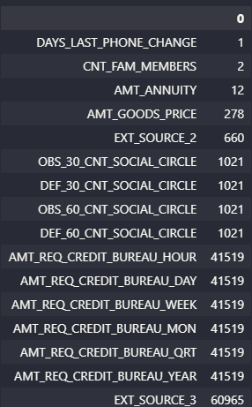
Application Data set: -
Rows and columns:
Missing values for Numerical data:

Slide 3
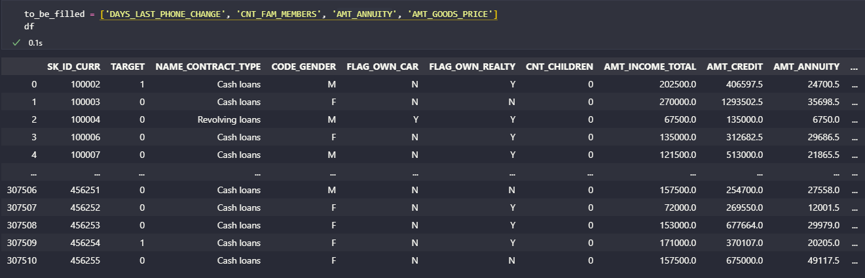
Filling missing Data: -
`DAYS_LAST_PHONE_CHANGE` being missing could either mean the customer hasnt changed his phone No or customer didnt fill this blank. So leaving it as it is would be better than filling in wrong values.
`CNT_FAM_MEMBERS` being missing could only mean that the customer didnt fill the blank. Taking the mean of the whole data set should help in this case to fill in the missing values.
`CNT_FAM_MEMBERS` was filled with its mean value being: 2.15266 (rounded off to 2).
`AMT_ANNUITY` are regular deposits and it cannot be filled with dummy values.

Slide 4
OUTLIERS: -
All these columns have been filtered out from the huge numerical column list since these are continuous type in nature.
Other dont hold much significance compared to this filtered list `outlier_cols`.

Slide 5
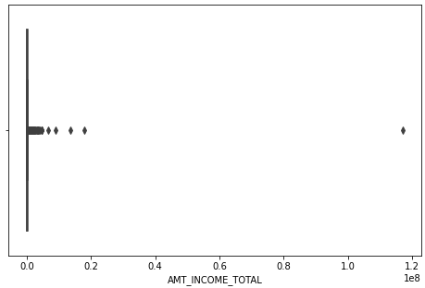
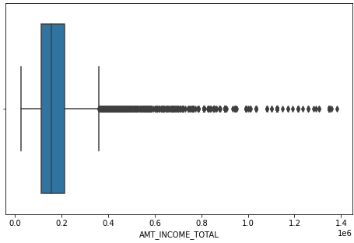
Feature: `AMT_INCOME_TOTAL`
Before removing then outliers
After removing the outliers

Slide 6
AMT_INCOME_TOTAL
`AMT_INCOME_TOTAL` has an outlier with around 1.2 * 10^8 as his/her salary. This particular data will skew the dataset so it will be removed.

Slide 7
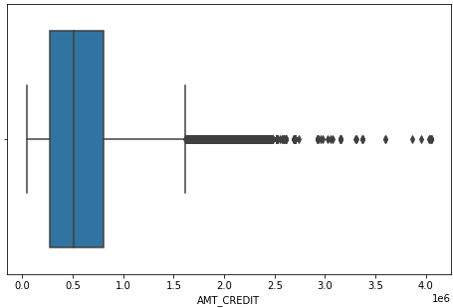
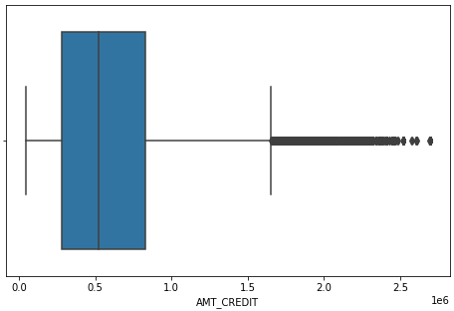
Feature: `AMT_CREDIT`
Before removing then outliers
After removing the outliers

Slide 8
AMT_CREDIT
AMT_CREDIT` has some decent outliers but it cannot be removed since it's not a false Data but an exceptional case. Some Outliers will be removed.

Slide 9
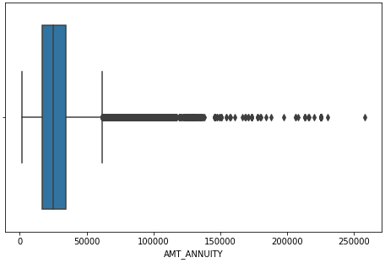
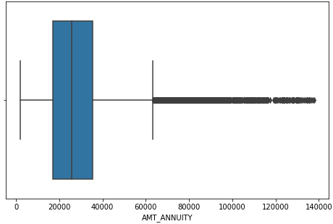
Feature: `AMT_ANNUITY`
Before removing then outliers
After removing the outliers

Slide 10
AMT_ANNUITY
`AMT_ANNUITY` also has significant outliers and have been removed.

Slide 11
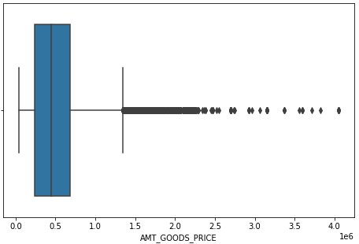
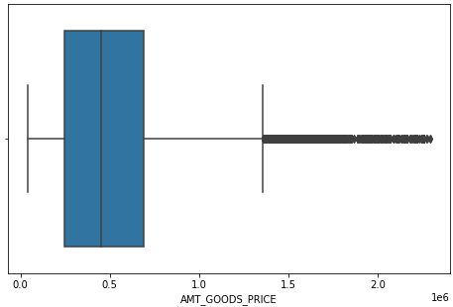
Feature: `AMT_GOODS_PRICE`
Before removing then outliers
After removing the outliers

Slide 12
AMT_GOODS_PRICE
`AMT_GOODS_PRICE` also has significant outliers and have been removed.

Slide 13
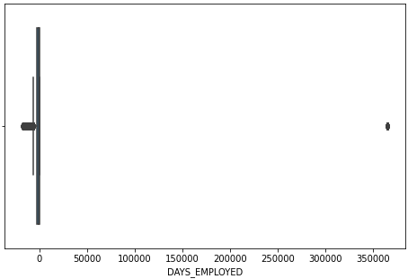
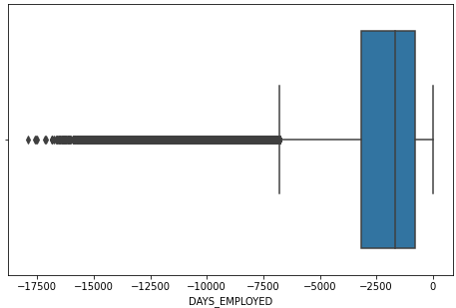
Feature: `DAYS_EMPLOYED`
Before removing then outliers
After removing the outliers

Slide 14
DAYS_EMPLOYED
`DAYS_EMPLOYED` has an outlier having its value above 350000. This many days is equivalent to atleast 900 years which is completely impossible so this data can be classified as False data and will be removed.

Slide 15
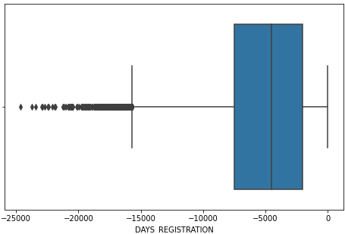
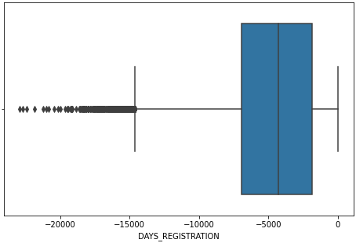
Feature: `DAYS_REGISTRATION`
Before removing then outliers
After removing the outliers
(No outliers were removed)

Slide 16
DAYS_REGISTRATION
`DAYS_REGISTRATION` has no significant outliers

Slide 17
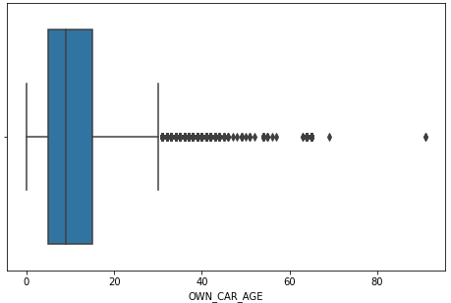
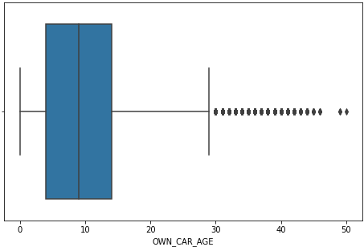
Feature: `OWN_CAR_AGE`
Before removing then outliers
After removing the outliers

Slide 18
OWN_CAR_AGE
`OWN_CAR_AGE` also has an outlier sitting at around 70 years of a cars Age. A car being at the age of 70 cannot be taken as a significantt value based data since it needs to be financially valuable. So this outlier will be rmoved as well.

Slide 19
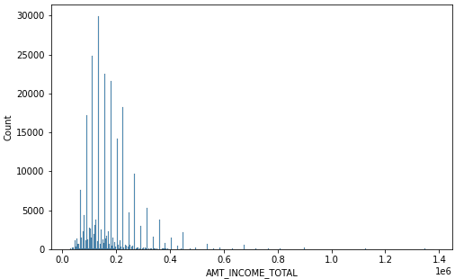
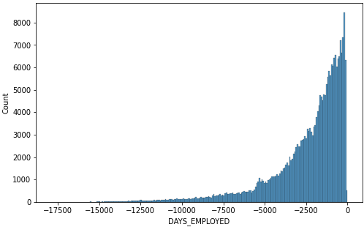
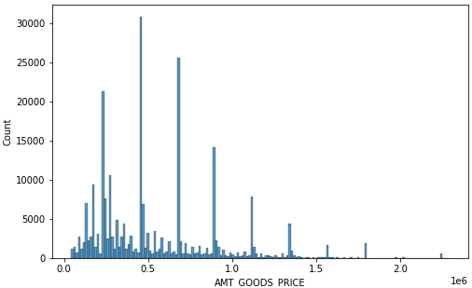
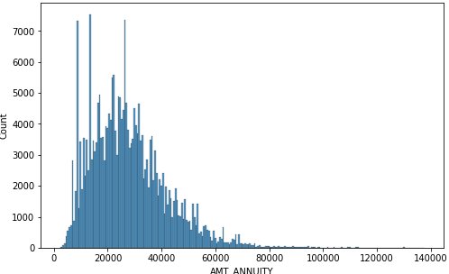
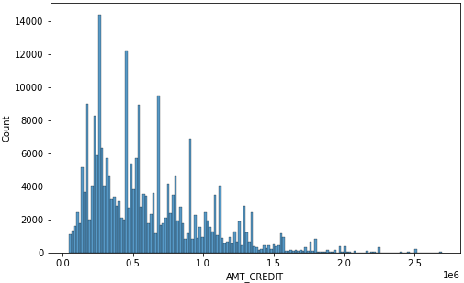
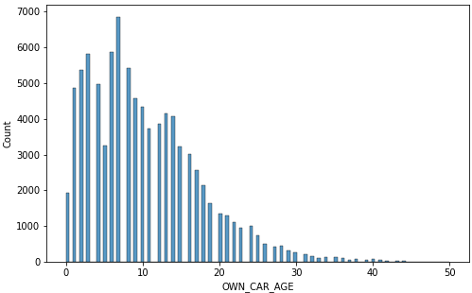
UNIVARIATE ANALYSIS: -
Normal distribution
exponential distribution
Normal distribution (with some huge value difference)
Normal distribution
Right skewed
Normal distribution

Slide 20
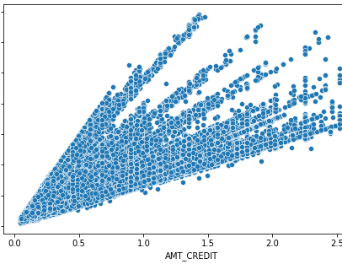
BIVARIATE ANALYSIS
AMT_CREDIT: Loan to be paid back with interest.
AMT_ANNUITY: fixed amount of money paid back to the loaner.
There is a linear relation between these two
variables.

Slide 21
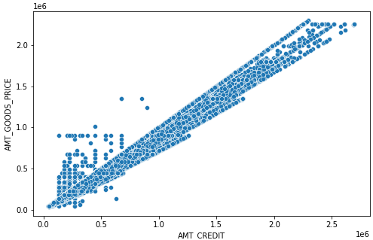
BIVARIATE ANALYSIS
AMT_CREDIT: Loan to be paid back with interest.
AMT_GOODS_PRICE: For consumer loans it is the price of the goods for which the loan is given.
Data which is scattered like a square and is above the linear line is where goods price is greater than the loan applied for which is the case when
the loaner needs only some amount of money
for the goods.
Data which is less than the loan is basically when
the customer needs modification to his goods which
exceeds the goods price.

Slide 22
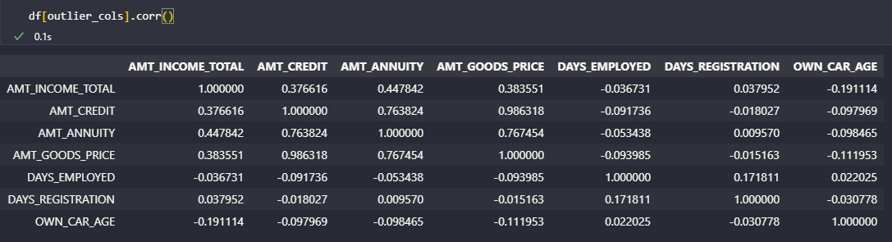
CORRELATION: -
Numerical Variables correlation

Slide 23
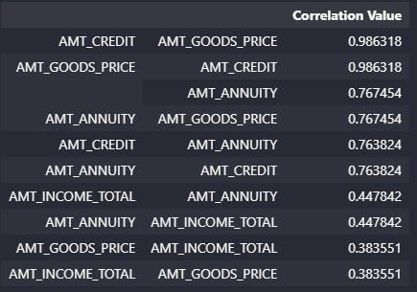
Top 10 Correlation: -
These are the top 10 correlation value holding numerical type data.
The highest correlation value being: 0.9863.
Ther first two features relation have been visualized in the above slides which shows that they are strictly linear which shows that the loan applied for is strictly for the goods price only 98.63% of the times.
The rest 1.37 % is also for goods but only a part of the goods amount was needed, or more than the price of goods were needed (maybe for some modifications to be done on the goods itself).

Slide 24
DRIVE LINK:
https://drive.google.com/drive/folders/1Lk6G3UA7r0zmKjbCBN5_B-fsoOL8z9ZZ?usp=sharing

